Slide 1
TRANSIMS Version 5 Application Concepts
January 20, 2011
David Roden – AECOM

Slide 2
Topics
Goals and objectives
NetPrep applications
Router applications
PathSkim applications
Microsimulator applications
Resent convergence discussions

Slide 3
Goals and objectives
Improve user interaction during network conversion
Separate link selection and collapsing from relational file generation
Streamline the application process
Consolidate processing steps
Minimize the number intermediate/working files (e.g., plan files)
Coordinate partitioned tasks to cumulate shared and dependent data (e.g., flow and travel times)
Performance statistics and reports based on all partitions
Improve performance and functionality for demand model feedback (i.e., skims)

Slide 4
Version 4 Network Preparation
Convert source data → link and node files
GISNet, TPPlusNet, EMME2Net, TransCAD GISDK
Develop a User Program script to manipulate link data fields
Review and edit link and node files
Synthesize TRANSIMS network with TransimsNet
Review network, refine parameters, re-run
Manually edit or provide Update/Delete commands
Review and edit signal and sign warrants
Synthesize traffic controls with IntControl
Coordinate signal offsets with Progression
(Similar process for transit networks)

Slide 5
Version 5 Network Preparation
Convert and edit source data → link and node files
NetPrep (input GIS, TP+, EMME/2, TRANSIMS network files)
Develop a User Program script to manipulate link data fields
Merge, select and collapse nodes and links
Apply Update/Delete commands
Review and edit link and node files
Synthesize TRANSIMS network with TransimsNet
Review network, refine parameters, re-run
Apply Update/Delete commands
Review and edit signal and sign warrants
Synthesize traffic controls with IntControl
Coordinate signal offsets with Progression

Slide 6
Network Preparation Differences
Greater focus on the initial develop of the input link and node file
Additional data manipulation and update/delete tools
Tools for selecting a subset of links from an all-streets network
TransimsNet includes much finer controls of synthetic data generation
Pocket lanes, link connections, activity locations, traffic controls, parking details, speeds, and other attributes

Slide 7
Router Applications
Additional path building controls and features
Forward or backward path building with trip end constraints
Expanded selection criterion
Time, location, zone, traveler type, mode, household, etc.
Build paths for individual travelers or trips within a household
More rigorous path building algorithm available to minimize transit transfer anomalies
Parking and vehicle operating costs included in path building
Can be varied by vehicle type
Traveler type script for traveler-specific path building parameters
Local impedance factor to avoid hard-limit effects

Slide 8
Router Performance Enhancements
Faster and integrated Router-based iterations
Create link-delays directly from Router
Independently control update of link flows and link travel-times
Build upon input flows / travel-times or start from free-flow conditions
Choice of periodic update vs. single final update
Multi-step incremental loading can be replaced with single application
PlanSum can be bypassed
Integrated Plan merging (PlanPrep)
Subset of input plans can be replaced with selective re-routing/update

Slide 9
Version 4 Router Applications
Trip File
LinkDelay
Router
TravelPlans.*
Plans.*
PlanPrep
TravelPlans.*
PlanSum
HHList.*
PlanSelect
LinkDelay

Slide 10
Version 5 Router Applications
LinkDelay
Trip File
TravelPlans.*
Router
LinkDelay
TravelPlans.*
Select.*
PlanSelect

Slide 11
Version 4 Travel Skims
Router + PlanSum
Enter a list of origin and destination Activity Locations
Set start time increments
Build a plan for each O-D-T
Long run times
Huge plan files
Use PlanSum to summarize the plans and aggregate zone or district skims
Limited O-D-T index size
Single output skim file
Select O-D-Ts
Link Delays
Router
Plans
PlanSum
Zone Skim

Slide 12
Version 5 Travel Skims
PathSkim
Multiple methods for automatically selecting origins and destinations
Multiple or merged variable length time periods
Start or end time points
One-to-many path building and save only skim data
No need to write/read plans
Location/zone/district skims
Multi-threading and time-period based partitioning
Link Delays
PathSkim
Skim.*

Slide 13
Microsimulator Applications
Version 4 Microsimulator
Single thread, limited network/demand size → subarea applications
Subarea polygon defines area for regional extraction
SubareaNet and SubareaPlans
Subarea link-delays merged with regional link-delays for feedback
Version 5 simulations
Multiple cores (threads or MPI) processing multiple subareas
Geographic subareas defined in the Node file using SimSubareas
Normally the CBD is selected as the central subarea
Lake Michigan makes subarea selection more challenging
Subareas can be defined once or updated during each iteration based on link vehicle hours of travel (i.e., load balancing)

Slide 14
Version 4 Microsimulator
Regional Plans.*
Regional Net
Regional Delays
SubareaPlans
SubareaNet
Subarea Plans
Subarea Net
LinkDelay
New Delays
PlanPrep
Feedback
Time Plans
Microsimulator
Subarea Delays

Slide 15
Version 5 Microsimulator
Regional Delays
Regional Plans.*
SimSubareas
PlanPrep
Subarea Nodes
Time Plans
Microsimulator
Regional Delays
Feedback

Slide 16
Microsimulator Feedback Loops
Trips / Tours
Router
Network
Travel Paths
Yes
Yes
Change?
Change?
Stop
Microsimulator
No
Bottlenecks
Travel Times

Slide 17
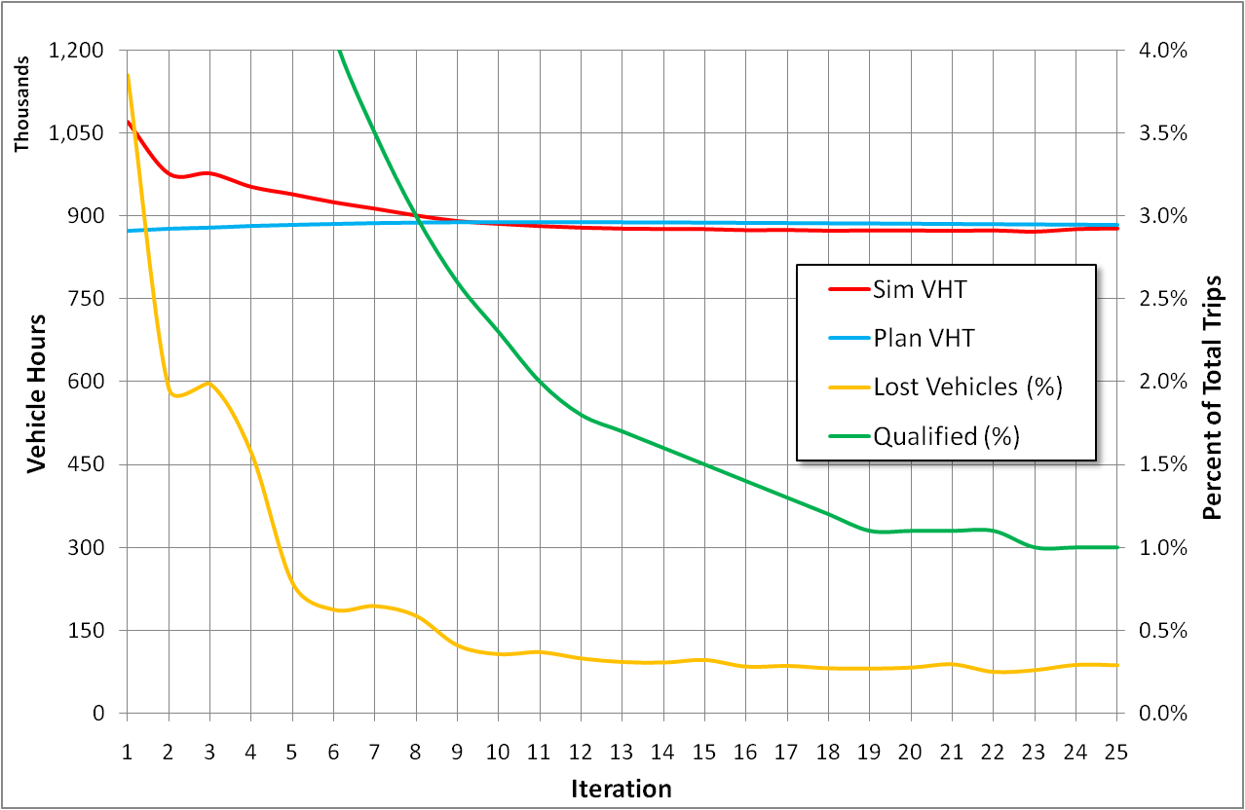
Process Convergence

Slide 18


Recent Convergence Discussions
Discussions with academics about Dynamic User Equilibrium (DUE) convergence using TRANSIMS
New performance measures
Link delay MSA averaging seems acceptable
Less comfortable with selected traveler feedback
Prefer simulating AON plans in each iterations
Since a unique path is built for each trip, gridlock concerns may be minimized

Slide 19
Equilibrium Statistics
Trip File
Simulated Times
Plan File
Router
Router
AON Flows
AON Plans
Re-Skim Plans
Simulated Flows
PlanCompare
Trip Gap
LinkSum
Relative Gap

Slide 20
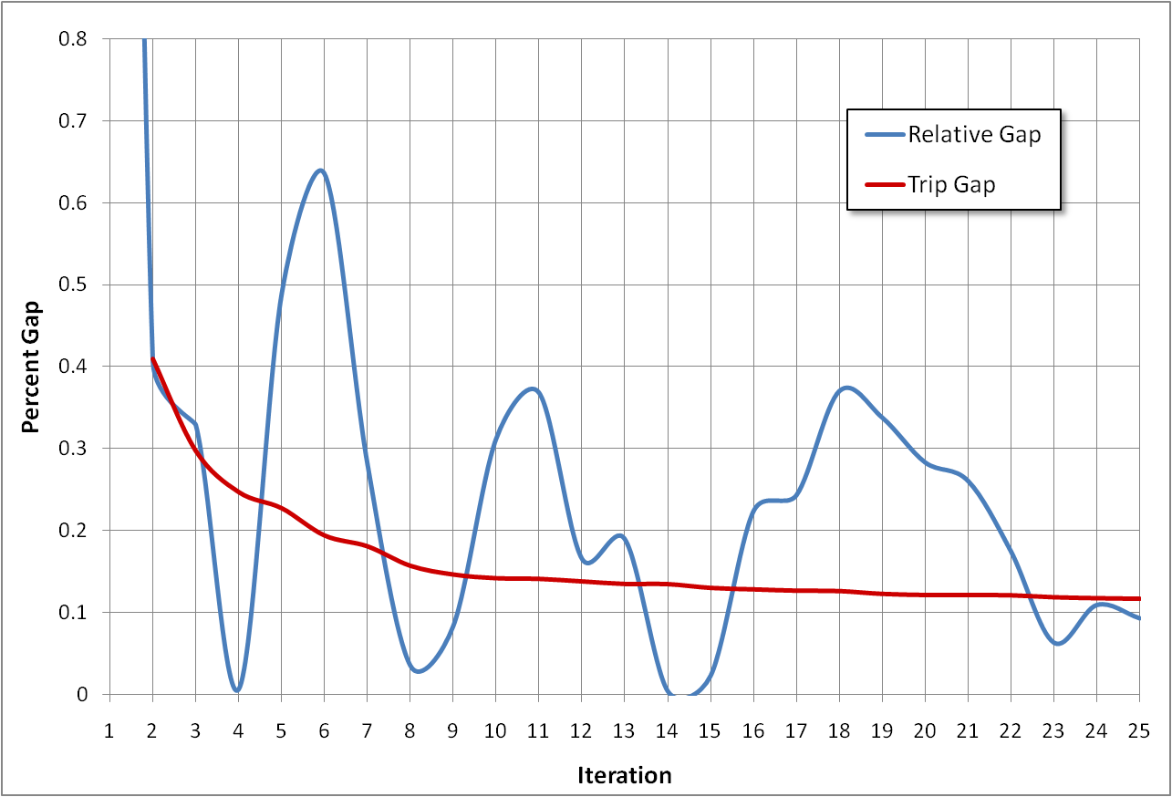
Equilibrium Convergence

Slide 21
Trip Gap by Time of Day and Iteration

Slide 22
Relative Gap by Time of Day and Iteration

